Slide 1
X-Copter
Development of a platform to test several sensors or
tasks for an autonomous aircraft

Slide 2
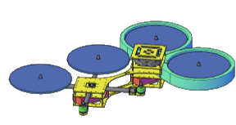
Introduction

Slide 3
Table of content
Project Management
Kinect and USB host controller
Power supply
Commercial flight controller
Flight test
Embedded Linux
WLAN
Simple flight controller

Slide 4
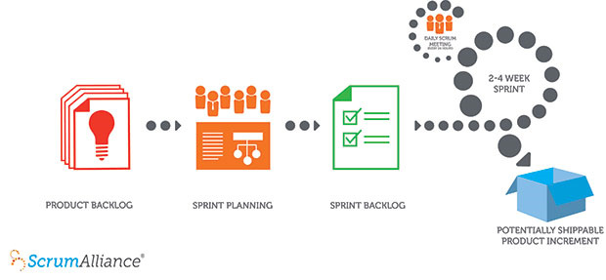
Project Management
Lecture by Mr. Balser
Scrum

Slide 5
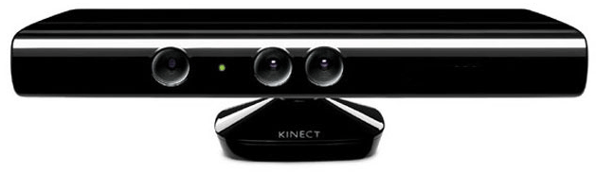
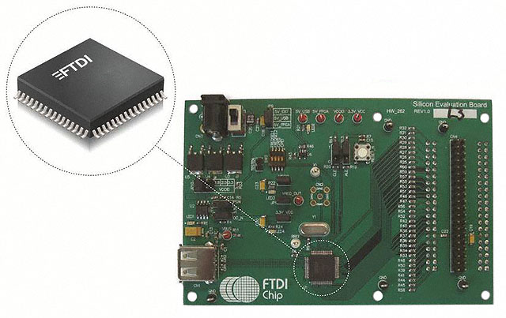
Kinect and USB Host Controller
Initial Situation
Requirements for the USB-Controller
Speed
Solderability
Linux Drivers
Possible USB-Controllers

Slide 6
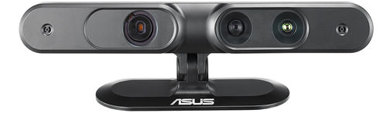
Kinect and USB Host Controller
Conclusion
Kinect unsuitable
Evaluation of ASUS Xtion PRO

Slide 7
Power supply Error detecting approach
Comparing generated circuits
Rebuilding circuit on plugboard with DIP parts
Testing with adjustable laboratory power supply
Using alternative parts and circuit

Slide 8
Power supply Detected Errors
Some parts maybe gone broken while testing
Different ICs in circuits used
No clean soldering joints
Exact parts from Texas Instruments not available

Slide 9
Reasons for commercial power supply
Generated Circuit from Texas Instruments not adaptable with DIP Parts
High error source
Oscillating circuit
New change-over from DIP to SMD would take too much time
Cheap and reliable power supplies available online

Slide 10
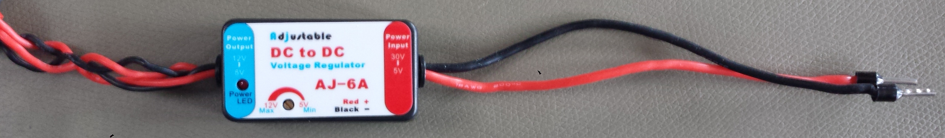
New Commercial power supply
Tech Specs
Input voltage range: 5V – 30V
Input power range: up to 5A
Output voltage range: 5V – 12V
Output power range: up to 5A

Slide 11
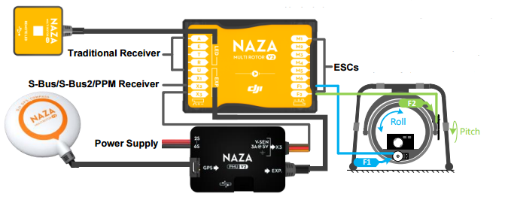
Commercial Flight controller
DJI NAZA m v2
Accelerometer, Gyro, GPS
Support for up to 8 motors

Slide 12
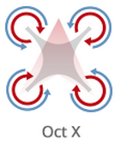
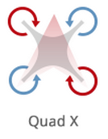
Configuration
DJI NAZA Assistant
Model type (Quad-/Hexacopter, Coaxial Quad)
Basic Sensor-/RC-Calibration

Slide 13
Flight-Modes
Manual
Atti. (Altitude hold)
GPS

Slide 14
Ready for take off
The first flight test and our perceptions

Slide 15

The „flight“

Slide 16
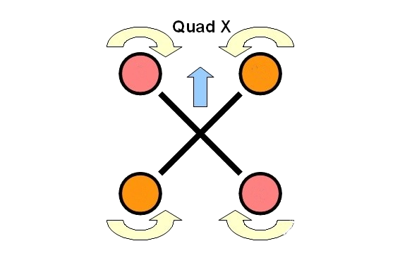
reasons for the crashes
Wrong assembly of the motors

Slide 17
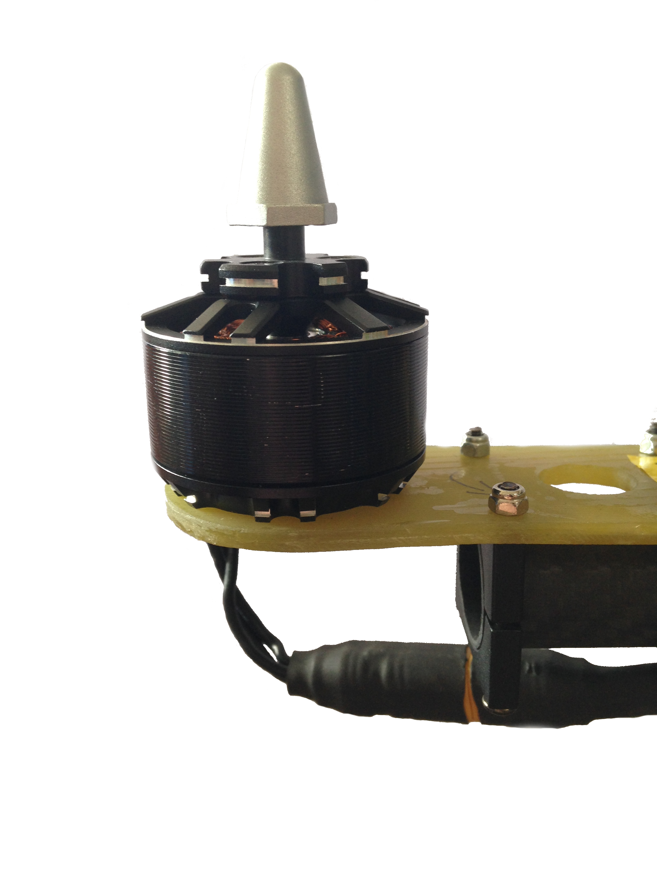
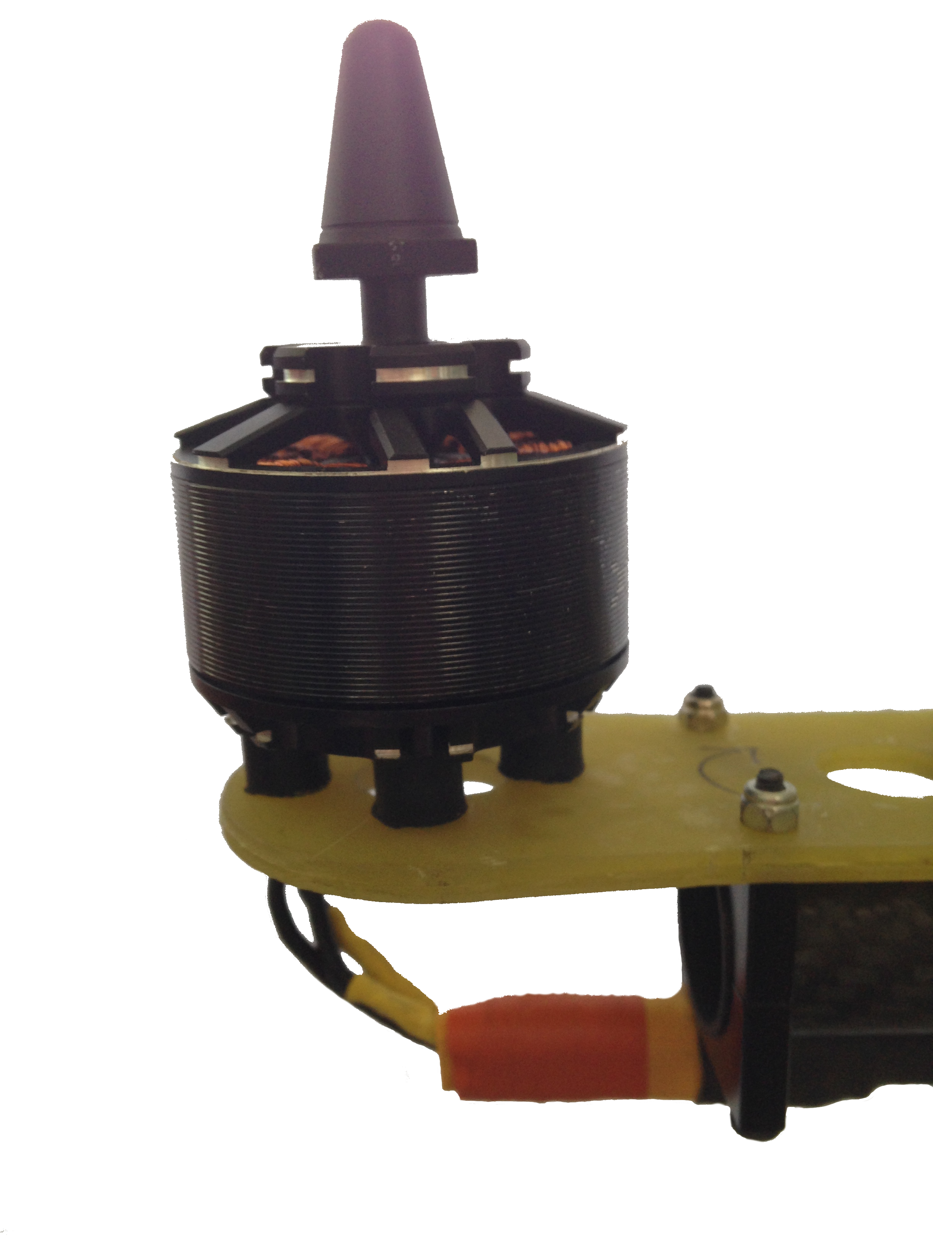
Reasons for the crashes

Slide 18
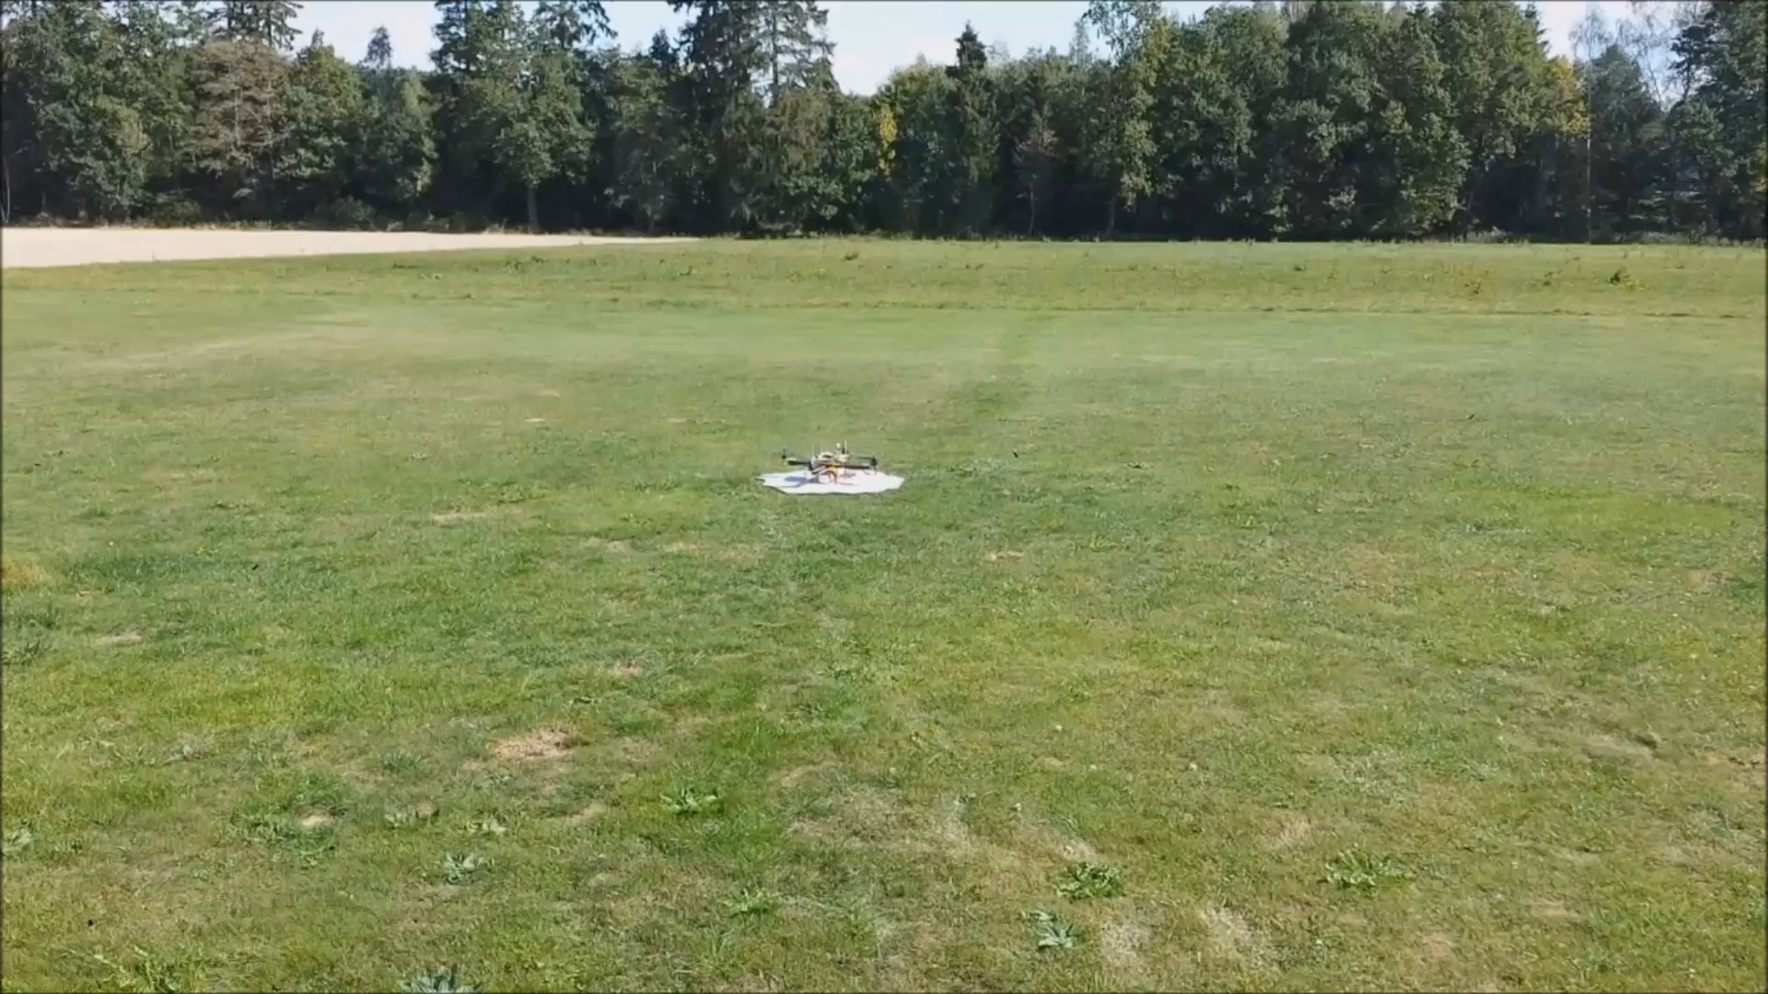
Time for the real flight

Slide 19
Embedded linux
Host System
Target System
Busybox
Program packages
Dev-Tools
Cross
Development
Toolchain
gcc
uClibc
Linux Kernel

Slide 20
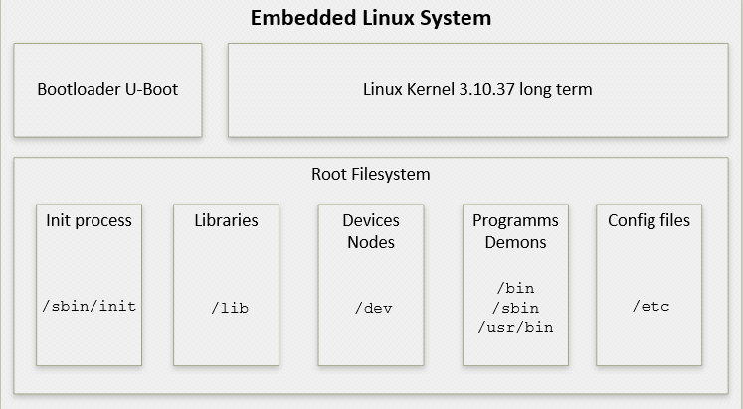

Slide 21

WLAN connectivity
CHALLENGES
BUILDROOT BEHAVIOR
settings
driver
firmware
CROSS COMPILER
makefile
compiler flags
CONNECTION
settings
IP-leasing

Slide 22
Simple Flight Controller
Replacing the commercial flight controller
Requirements:
For Quadcopter
Manual height control
Automatic position holding
Automatic balance
Automatic spinning control
Using accelerometer and gyro meter

Slide 23
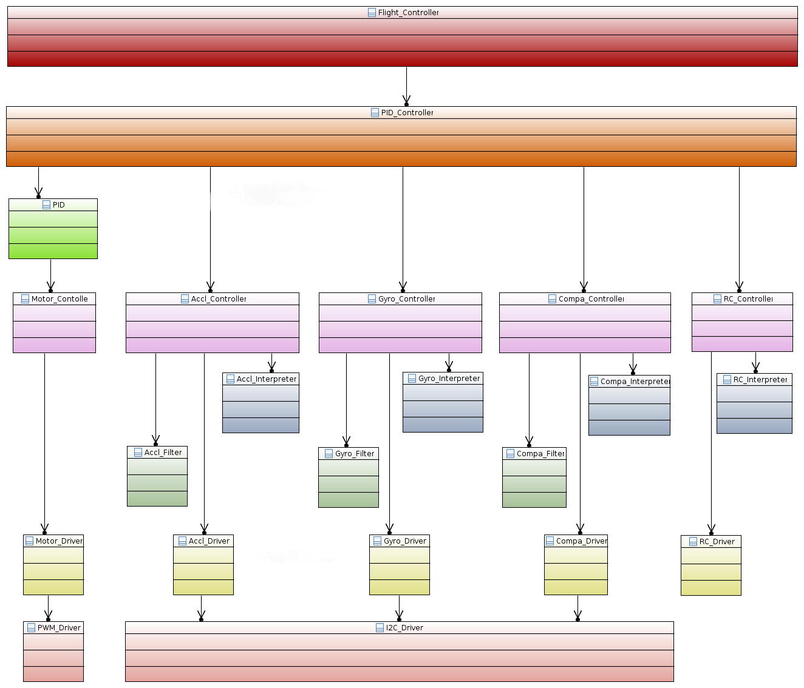

Slide 24
Simple Flight Controller
Development Status Demonstration

Slide 25
End
Thank your for you attention

